Slide 1

Bite Buddy
Presented by Team 2

Slide 2
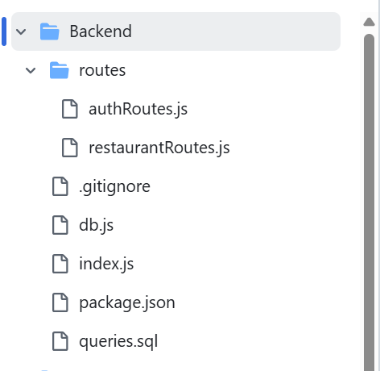
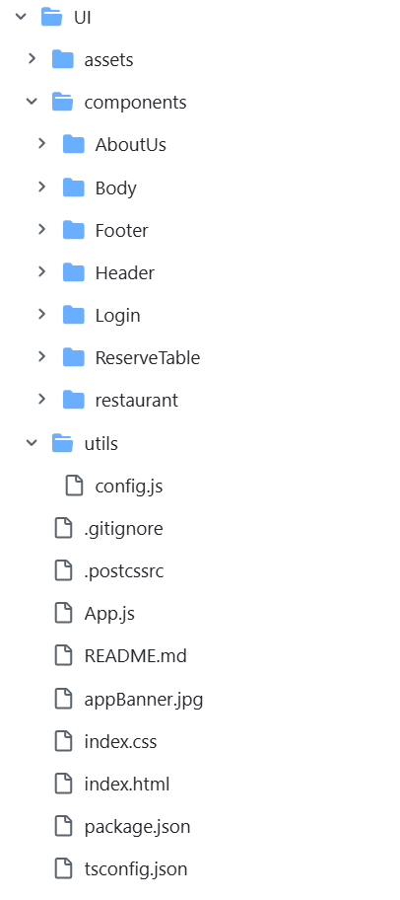
Github Folder Structure
Back-end Structure
Front-end Structure

Slide 3
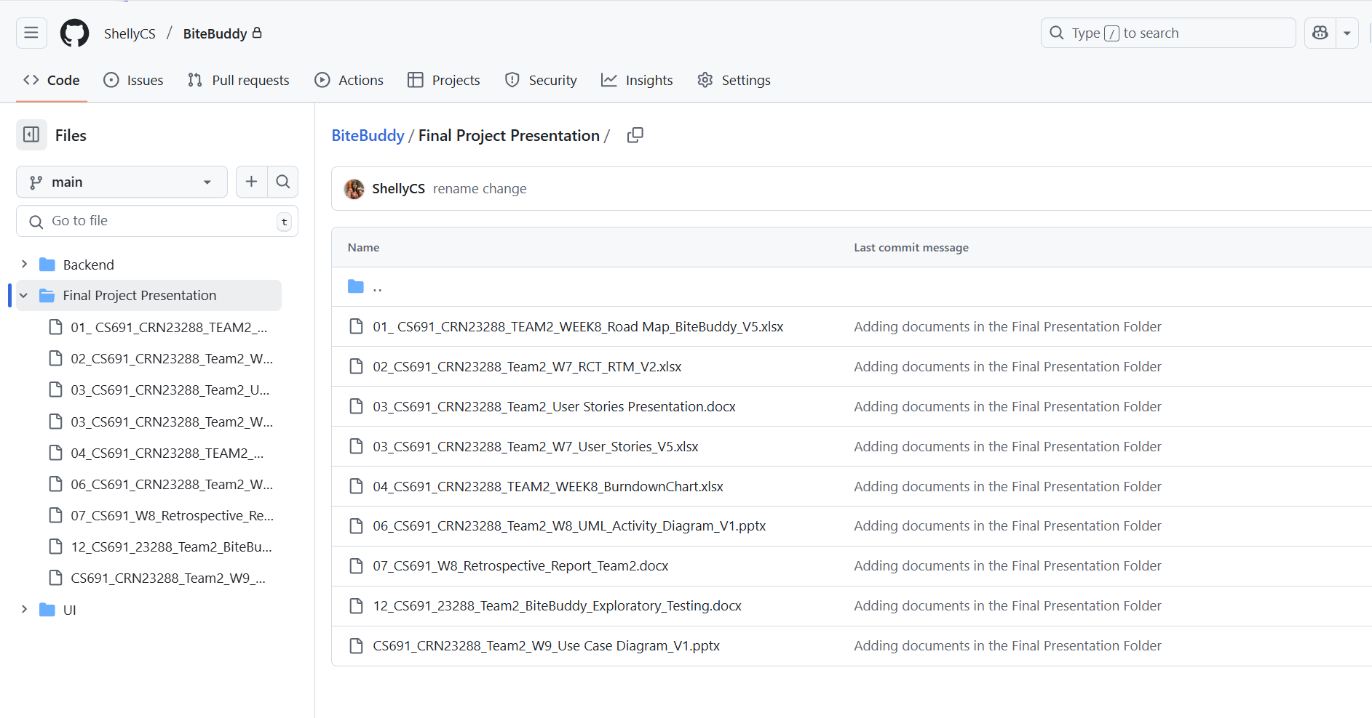
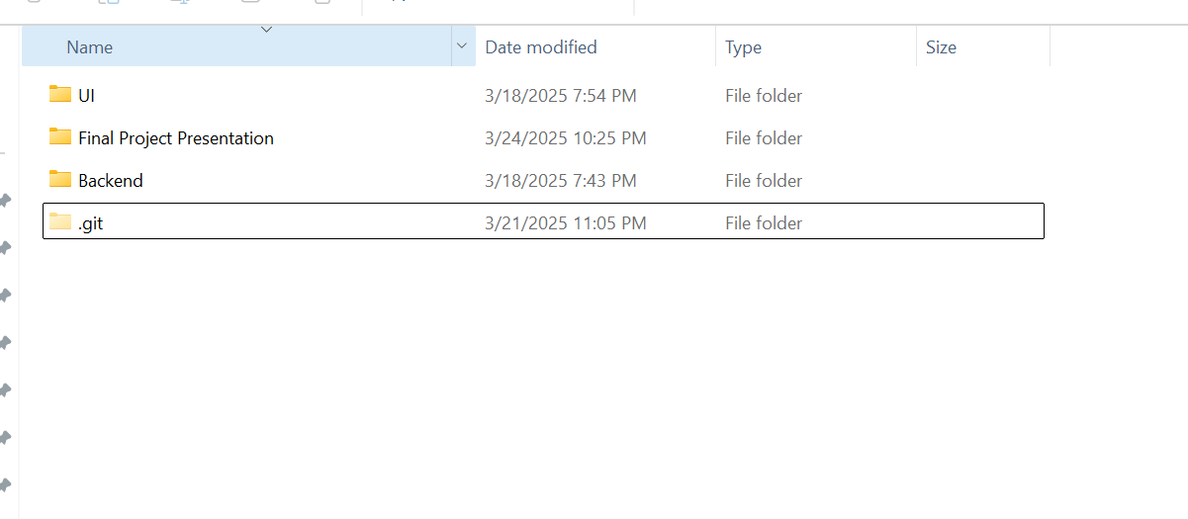
Github Folder Structure Cont.

Slide 4
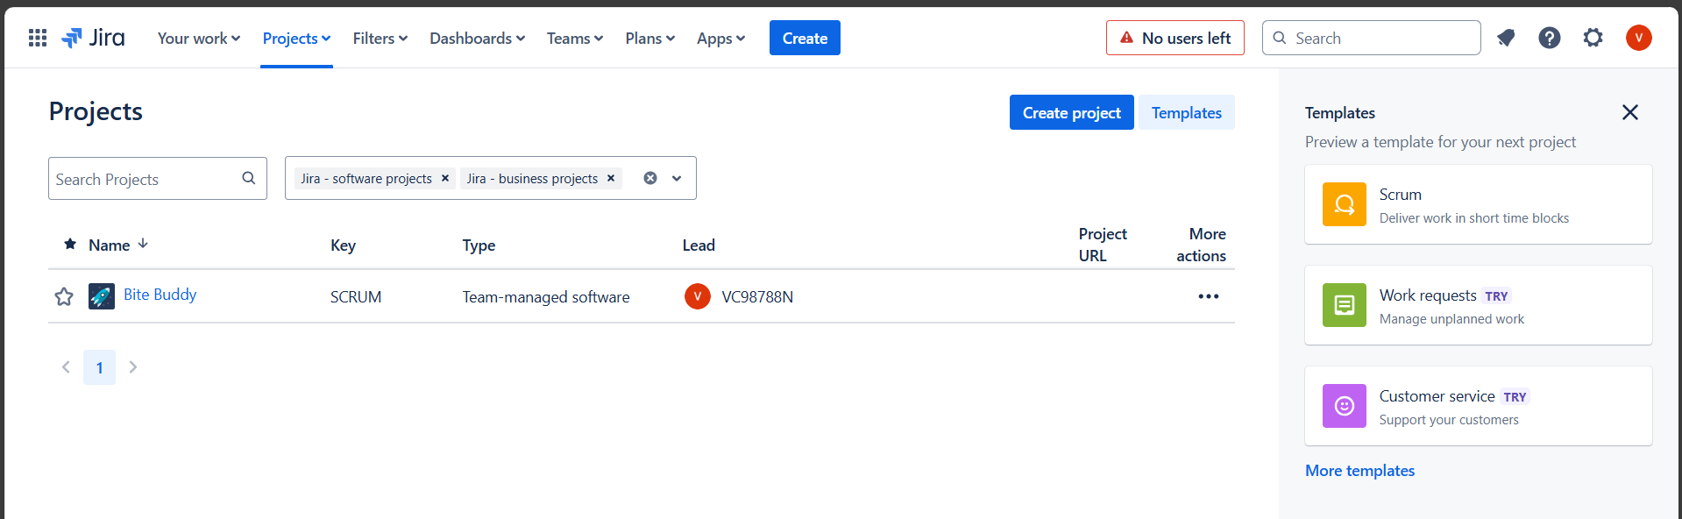
JIRA
The project site on the Atlassian Jira application is named as “Bite Buddy” a team-managed project on JIRA.

Slide 5
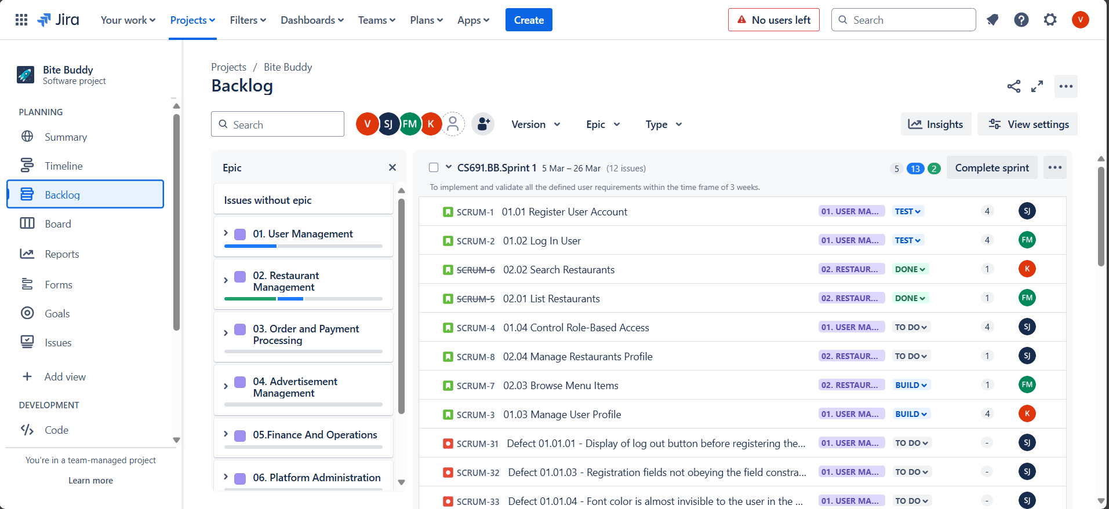
Epics and User Stories on JIRA

Slide 6
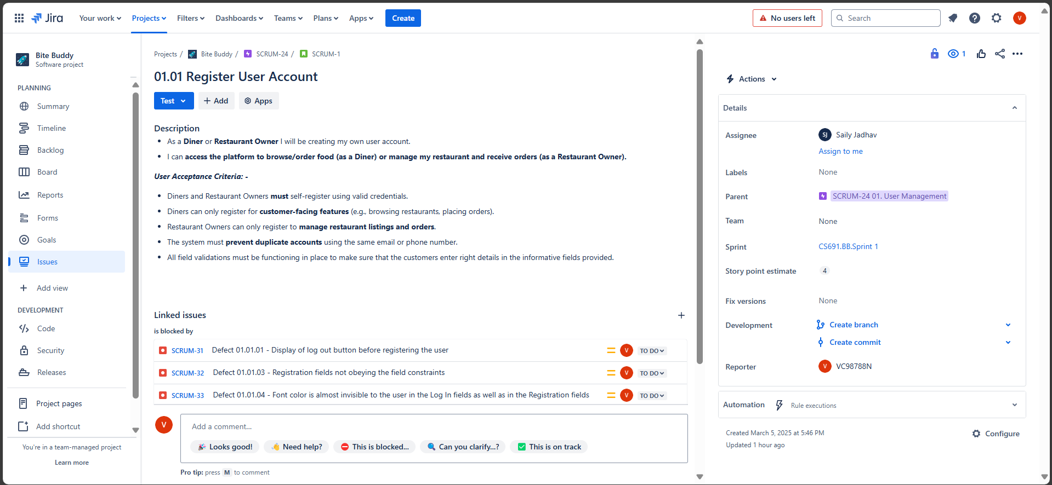
User stories on JIRA

Slide 7
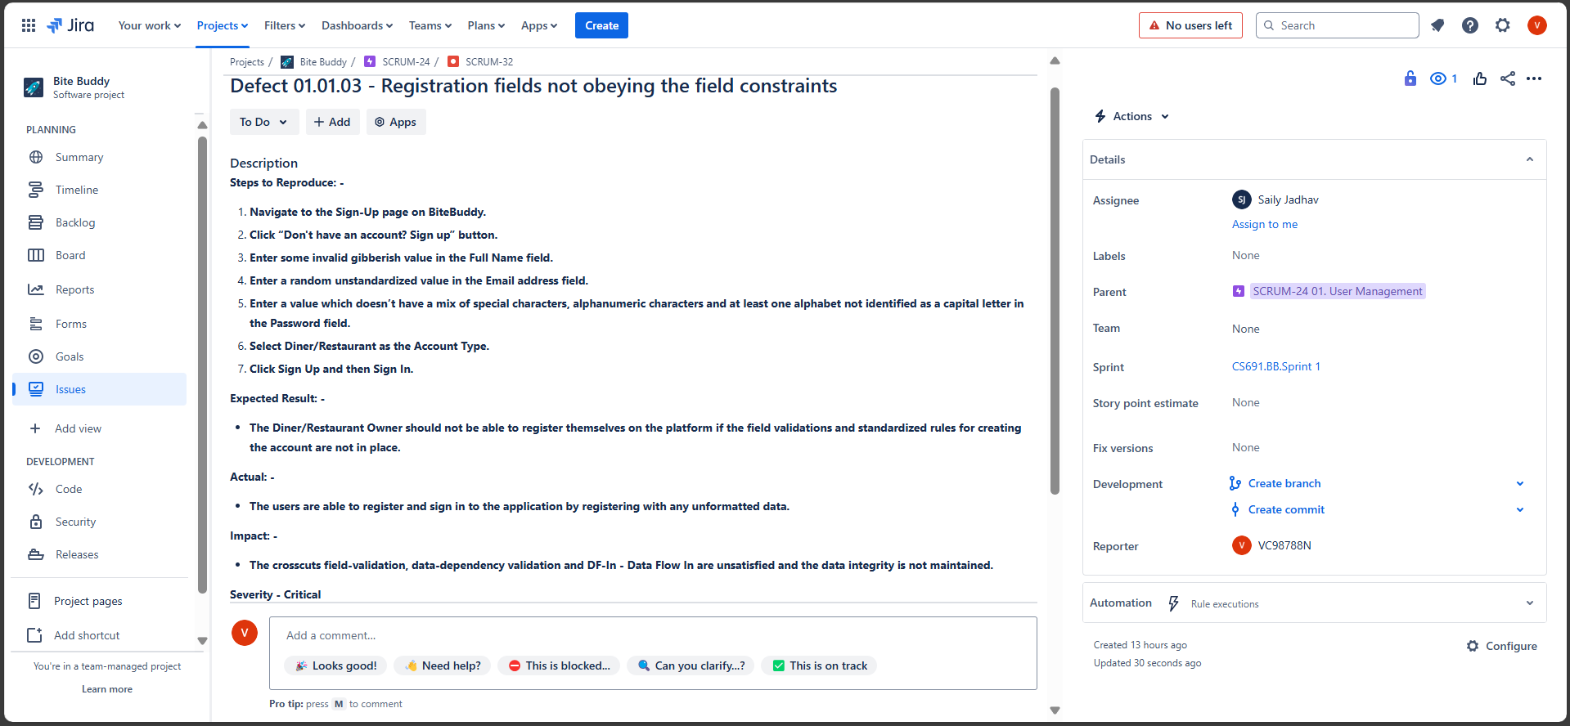
Defects on JIRA

Slide 8
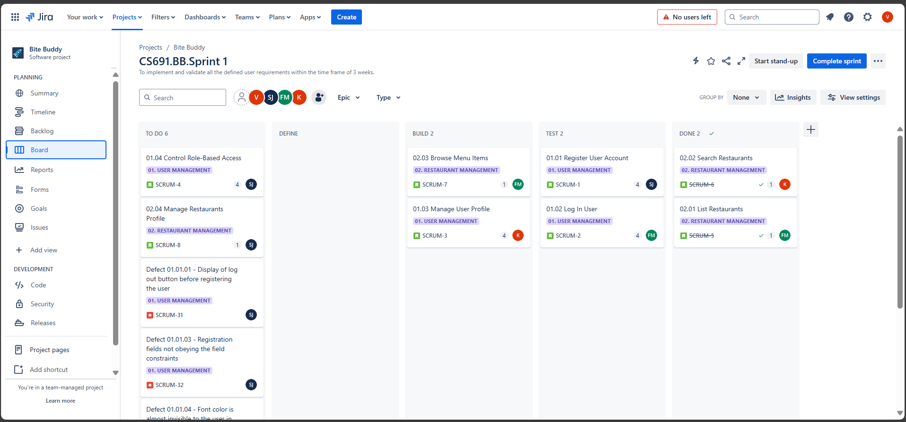
Kanban Board on JIRA

